Slide 1
A Rechargeable Lithium Battery Model Charge and Discharge Cycle
The model is based on the study by
John Newman, et al. [1]
[1] M. Doyle, J. Newman, A.S. Gozdz, C.N. Schmutz, J.M. Tarascon, J. Electrochem. Soc., 143, p. 1890, 1996.

Slide 2
Introduction
The transient charge and discharge performance of a battery is strongly dependent on the design and choice of materials. This model allows engineers and scientists to investigate the behavior of a Li-ion cell based on a number of design parameters.
The model predicts cell voltage, capacity, current distribution, and concentration in the electrolyte and in the electrode particles during operation.
Results:
The results in the reference paper are reproduced by the model.
The results allow for detailed studies of the concentration polarization and the current distribution in the battery during discharge.
This model can be used and modified to describe most commercial Li-ion batteries during discharge and charge.

Slide 3
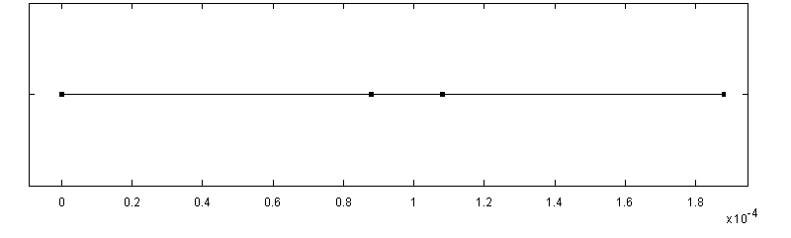
Model Definition - Geometry
The geometry is parameterized, which makes is easy change dimensions.
A 1D geometry represents the width of the cell.
The transport and reactions along the radius of the active particles are modeled in a separate extra dimension in the two electrode domains.
100µm
Negative
Electrode
174 µm
Positive
Electrode
50 µm Separator
Particle Model
r
Negative
Electrode
Positive
Electrode
1D Battery Assembly

Slide 4
Model Definition – Equations
Electronic current density balance:
Butler-Volmer electrode kinetics:
Ionic charge balances and material balances in the electrolyte:

Slide 5
Model Definition – Equations
Diffusion and reaction of Li in the solid particles is modeled using Farady’s law and the spherical diffusion-reaction equation:
This equation is built-in using the Li-Ion battery interface:

Slide 6
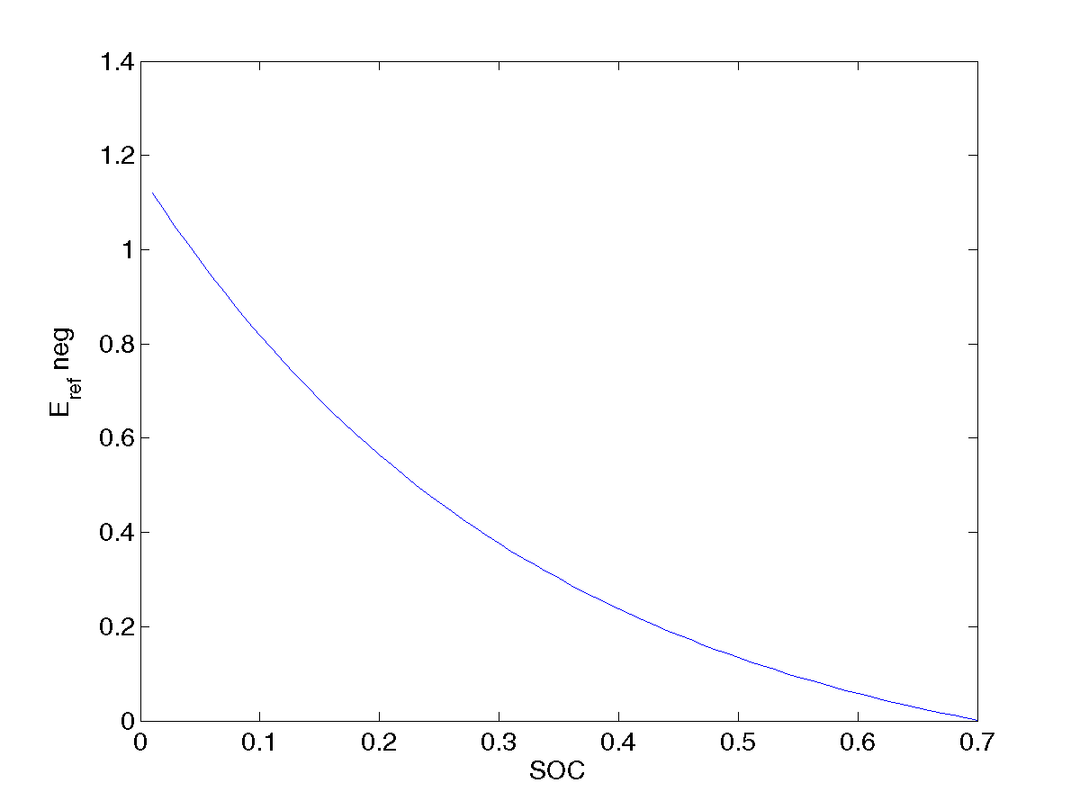
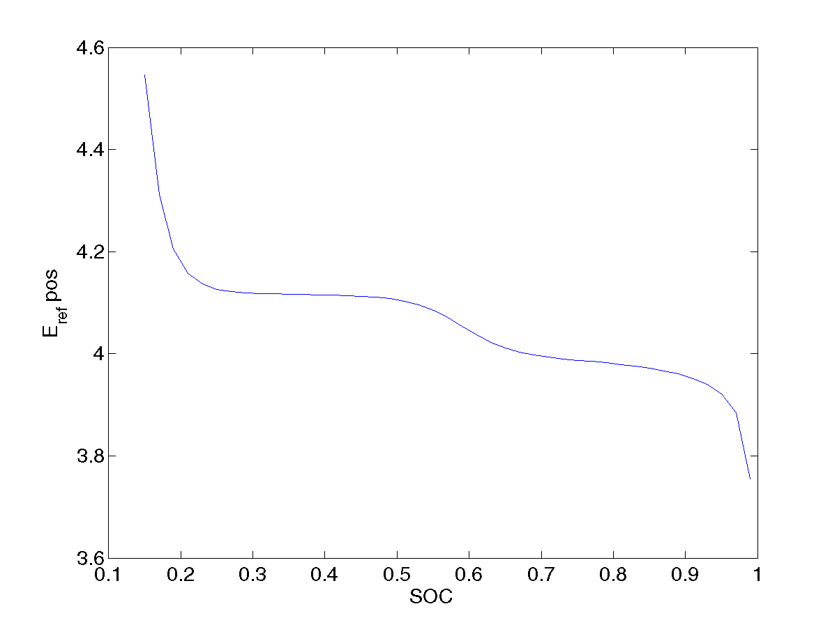
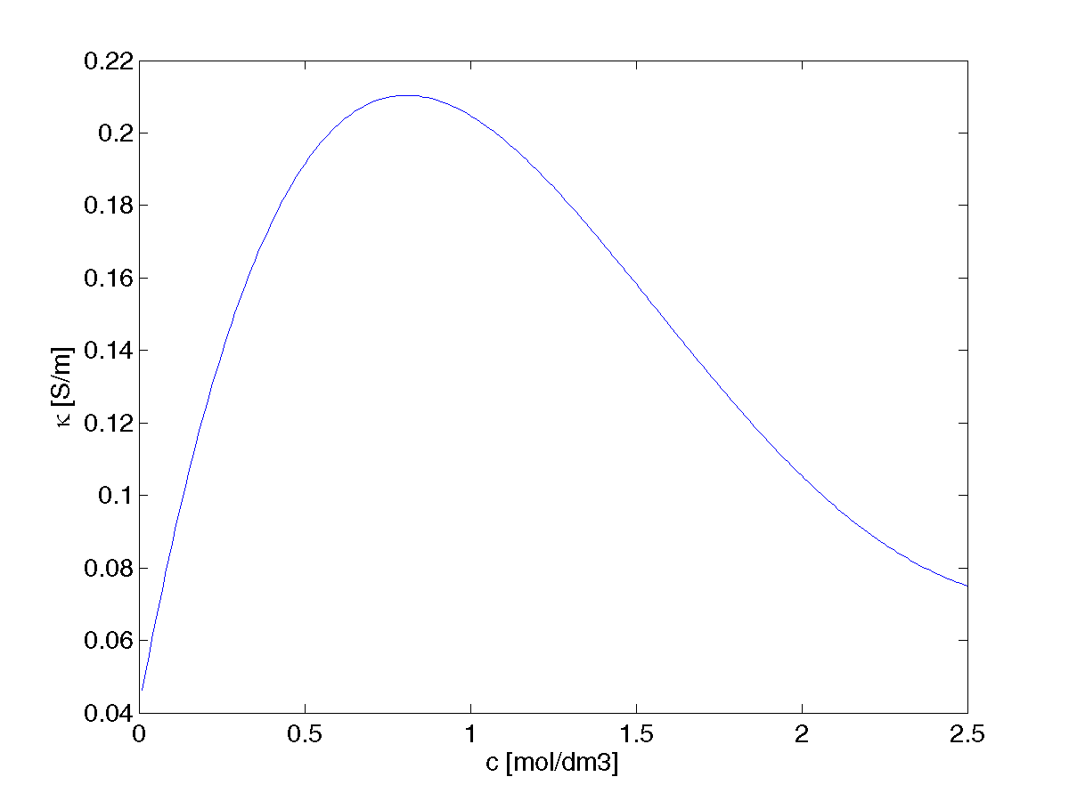
Model Definition – Parameters
The battery consists of a carbon-based negative electrode (MCMB), a LiMn₂O₄ positive electrode, and a gel electrolyte made of 1:2 EC:DMC with 2 mol/dm3 LiPF₆ salt.
Experimental data, available through interpolation functions, describe the ionic conductivity as function of concentration and electrode potentials as functions of state of charge (SOC).
Negative electrode
equilibrium potential, E_{ref}
Positive electrode
equilibrium potential, E_{ref}
Ionic
conductivity, κ₂

Slide 7
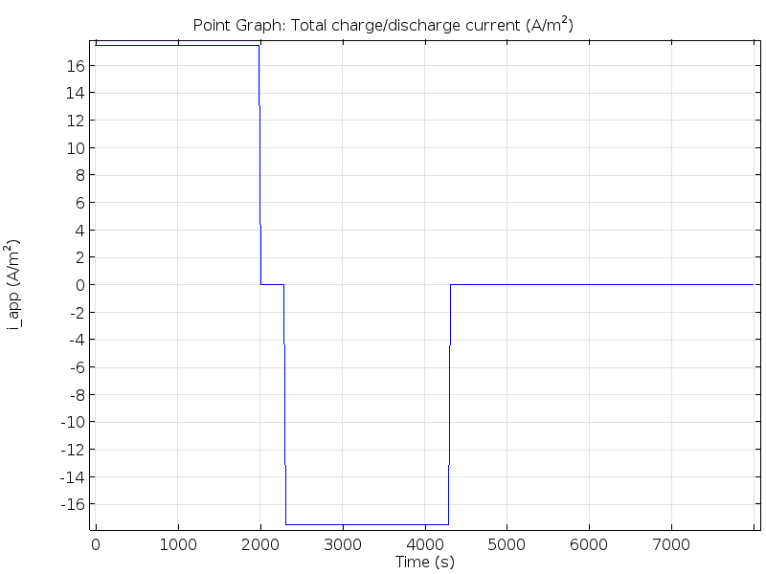
Model Definition – Initial & Boundary Conditions
Initial conditions:
Ecell = 4.2V
c2=2000 mol/m3
Boundary conditions, charge balances:
Negative electrode: zero potential and zero ionic current.
Positive electrode: zero ionic current and electronic current density according to:
i1 (0<t<2000s) =i_discharge
i1 (2300<t<4300s) =i_charge
otherwise zero current
Electrode/electrolyte interfaces: zero electronic current.
Boundary conditions, material balances:
Zero flux for c2 at current collectors
Zero flux for c1 at r=0
Flux specified for c1 at r=1

Slide 8
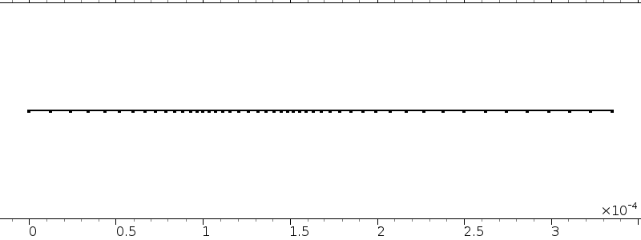
Model Definition – Mesh, Solver
Generated Mesh:
47 elements along the cell thickness
10 elements along the particle radius
634 degrees of freedom
Time Dependent Study:
Discharge from 0 to 2000 s
300 s of relaxation
2000 s of recharge
Output generated in increments of 10 s

Slide 9
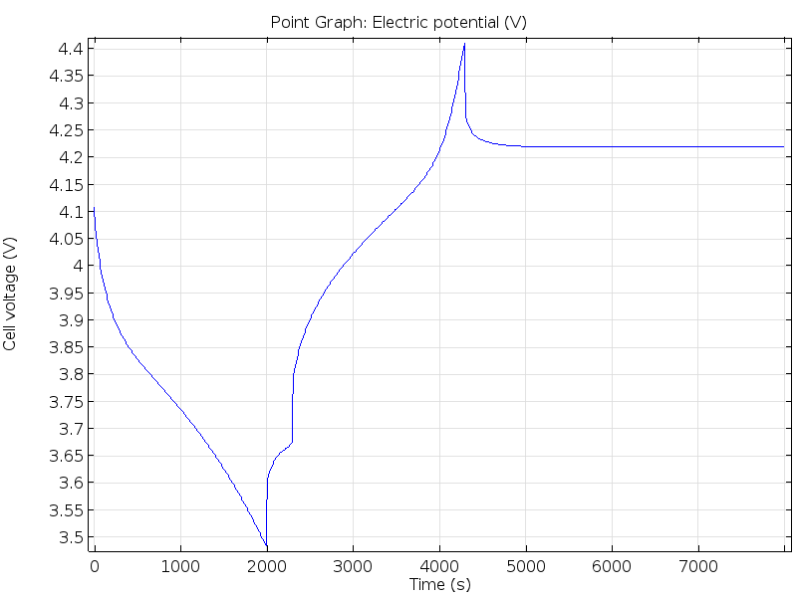
Results: Cell Voltage Discharge-Charge Cycle
After 2000 s of discharge (55 % capacity) the cell voltage is 3.5 V.
After 300 s relaxation the cell voltage has increased to 3.65 V.
At the end of the subsequent charging stage there is a significant voltage increase.

Slide 10
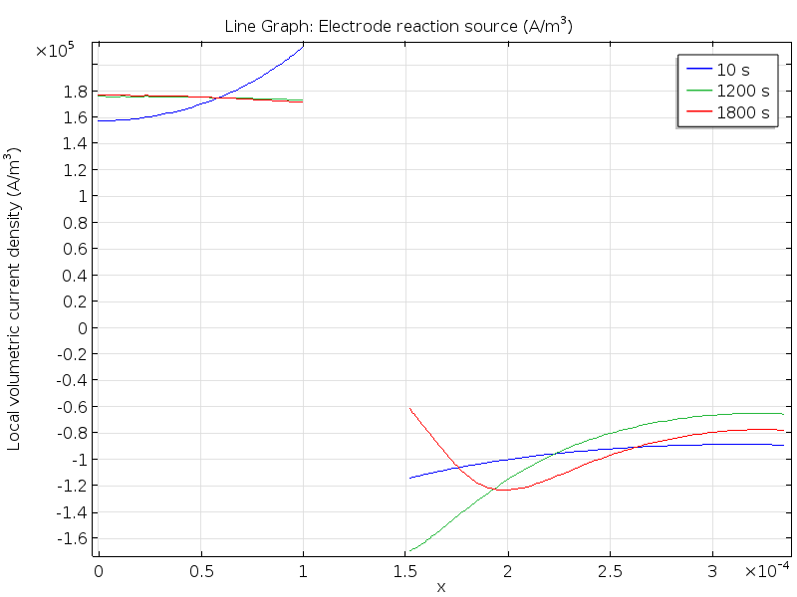
Results: Charge Transfer Current Density Distribution

Slide 11
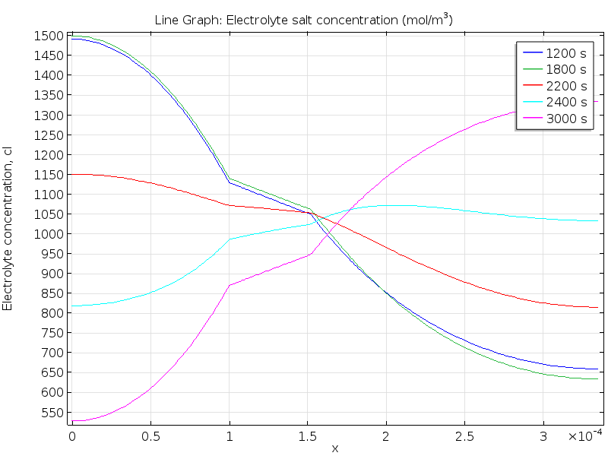
Results: Concentration Distribution
The electrolyte concentration reaches a steady-state during charge.

Slide 12
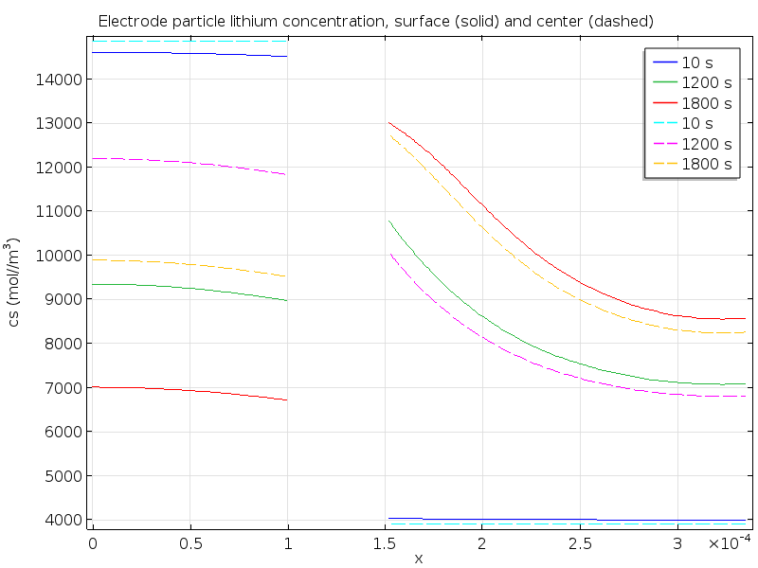
Results: Solid Phase Concentration Polarization
At the end of the 2000 s discharge stage, the positive electrode is subjected to a large variation in Li-concentration caused by the nonuniform current density distribution.
Negative electrode
Positive electrode

